Slide 1
Introduction to Abstract Data Types
Topic 1

Slide 2
Chapter Contents
2.1 A first look at ADTs and Implementations
2.2 C++'s Simple Data Types
2.3 Programmer-Defined Data Types
2.4 Pointers

Slide 3
Chapter Objectives
Distinguish between ADTs and implementations of ADTs
Review C++'s simple data types & ADTs they model
See examples of how implementations of ADTs are sometimes insufficient
Look at simple mechanisms to define new data types
Take a first look at pointers and pointer operations

Slide 4
First Look at ADTs & Implementations
For a programming task we must identify
The collection of data items
Basic operations to be performed on them
Taken together (data items & operations)
are called an Abstract Data Type (ADT)
Implementation
Storage structures for the data items
Algorithms for the operations

Slide 5
C++ Simple Data Types Integers
Unsigned integers
unsigned short, unsigned, unsigned long
Sometimes called whole numbers
Represented in 2, 4, or 8 bytes
Signed integers
short, int, long
represented in two's complement

Slide 6
Two's Complement Representation
For nonnegative n:
Use ordinary base-two representation with leading (sign) bit 0
For n < 0
Find w-bit base-2 representation of |n|
Complement each bit.
Add 1

Slide 7
Two's Complement Representation
Example: –88
88 as a 16-bit base-two number 0000000001011000
Complement this bit string 1111111110100111
Add 1 1111111110101000
One complement
WHY?
Two complements

Slide 8
Two's Complement Representation
Works well for arithmetic computations
5 + –6:
0000000000000101
+1111111111111010
1111111111111111
What gets done to the bits to give this answer?

Slide 9
Problems with Integer Representation
Limited Capacity — a finite number of bits
An operation can produce a value that requires more bits than maximum number allowed. This is called overflow .
None of these is a perfect representation of (mathematical) integers
Can only store a finite (sub)range of them.
See Demonstrations Fig. 2.1See Demonstrations Fig. 2.1, Fig. 2.2

Slide 10
C++ Simple Data Types Real Data
Types float and double in C++
Use single precision (IEEE Floating-Point)
Store:
sign of mantissa in leftmost bit (0 = +, 1 = – )
represent exponent in next 8 bits (exponent + 127)
bits b₂b₃ . . .b₂₄ mantissa in rightmost 23 bits.
Need not store b₁ — (we know it's 1)

Slide 11
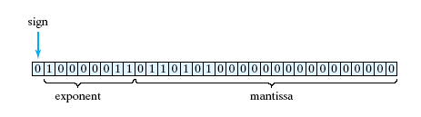
Real Data
Example: 22.625 = 10110.101₂
Floating point form: 1.0110101₂ * 2₄

Slide 12

Problems with Real Representation
Exponent overflow and underflow
Round off error
Most reals do not have terminating binary representations.
Example:
0.7 = (0.10110011001100110011001100. . .)₂

Slide 13
Problems with Real Representation
Round off error may be compounded in a sequence of operations.
Real-world example – Gulf War Patriot missile guidance affected by accumulated round off
Be careful in comparing reals
with == and !=.
Instead use comparison for closeness if (abs (x – 12.34) < 0.001) …

Slide 14


C++ Simple Data Types Character Data
1 byte for ASCII, EBCDIC
2 bytes for Unicode (java) or C++ wide character type
Operations ==, <, >, etc. Using numeric code

Slide 15
C++ Simple Data Types Boolean Data
Values { false, true }
Could be stored in bits, usually use a byte
Operations &&, ||
In C++
bool type
int (boolVal) evaluates to
0 if false
1 if true

Slide 16
Programmer-Defined Data Types
Typedefs
Mechanism usable to create a new type
Give new name to existing type
Example:
typedef double real;
Now either double or real can be used.

Slide 17

Programmer-Defined Data Types
Enumerations
Mechanism for creating types whose literals are identifiers
Each identifier associated with unique integer

Slide 18
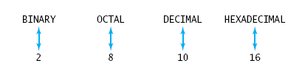
Programmer-Defined Data Types
Also possible to specify explicit values to give the enumerators enum NumberBase { BINARY = 2, OCTAL = 8, DECIMAL = 10, HEXADECIMAL = 16};

Slide 19
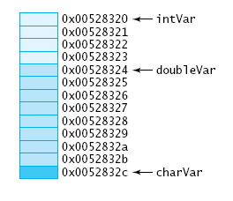
Pointers
When regular variables are declared
Memory allocated for value of specified type
Variable name associated with that memory location
Memory initialized with values provided (if any)
27

Slide 20
Pointers
Pointer Variables
value stored is a memory address
Note sample program, Fig. 2.4
Declares variables that can store int addresses and double variables
Displays the addresses

Slide 21

Basic Pointer Operations
Dereferencing and indirection
Pointer variable stores address of a location
Accessing contents of that location requires dereferencing operator *
Note program example Fig 2.5

Slide 22
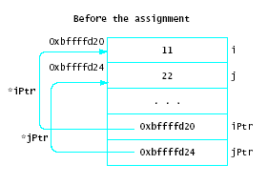
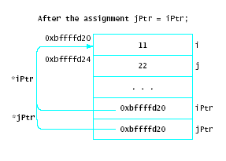
Basic Pointer Operations
Assignment
Pointer variables can be assigned the values of other pointer variables bound to same type

Slide 23
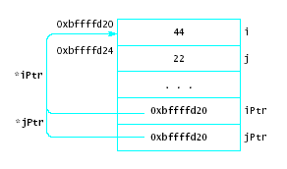
Basic Pointer Operations
Consider *jPtr = 44;
Changes value that both pointers reference
Not good programming practice, hard to debug
Known as aliasing problem

Slide 24
Basic Pointer Operations
Comparison
Relational operators used to compare two pointers
Must be bound to same type
Most common = = and !=
The null address may be compared with any pointer variable

Slide 25

Dynamic Memory Allocation
The new operation
Example int * intPtr; intPtr = new int;
An anonymous variable
Cannot be accessed directly

Slide 26
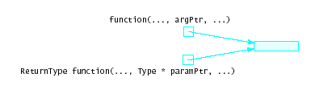
Pointer Arguments
Pointers can be passed as arguments to functions
This is logically equivalent to reference parameters
In fact, this is how early C++ compilers accomplished reference parameters

Slide 27
Data Structures and Abstract Data Types
Chapter 3

Slide 28
Chapter Contents
3.1 Data Structures, Abstract Data Types and Implementations
3.2 Static Arrays
3.3 Multidimensional Arrays (optional)
3.4 Dynamic Arrays
3.5 C-Style Structs (optional)
3.6 Procedural Programming

Slide 29
Chapter Objectives
Look at ADTs, implementations in detail
Introduce arrays as ADTs
See arrays implemented as C++ static arrays
(Optional) Describe multidimensional arrays
Extend pointers to use in dynamic arrays
(Optional) Show use of C++ structs to model objects with multiple attributes
Show example of procedural programming paradigm

Slide 30

Data Structures, Abstract Data Types, and Implementations
Consider example of an airplane flight with 10 seats to be assigned
Tasks
List available seats
Reserve a seat
How to store, access data?
10 individual variables
An array of variables

Slide 31
Data Structures, Abstract Data Types, and Implementations
Implementation consists of
Storage (data) structures
Algorithms for basic operations
Note following figure
C++ provides large collection of data types and structures

Slide 32
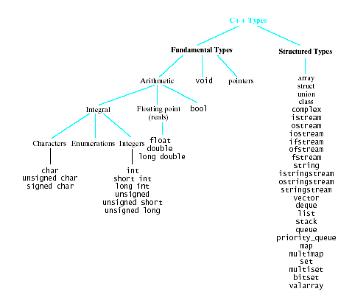
C++ Types

Slide 33
Arrays
Collection of data elements
All of same type
Each accessed by specifying position
Static array
Compiler determines how memory allocated
Dynamic array
Allocation takes place at run time

Slide 34

Single Dimension Arrays
Syntax: ElementType arrayName [CAPACITY]; ElementType arrayName [CAPACITY] = { initializer_list };
Example: int b [10];
Elements accessed by
name and [ ] operation b[5]

Slide 35

Character Arrays
Elements of an array may be of any type
Including characters
Example: char name [NAME_CAPACITY] = "John Doe";
If array initialized shorter than specs
extra locations filled with null character

Slide 36
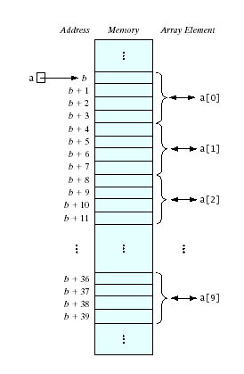
Subscript Operation
We have said elements accessed by name and [ ] numList[5]
Consider the [ ] to be an operator
The subscript operator
Performs address translation
Name of the array is a pointer constant
The base address

Slide 37
Using Arrays
Accessing array for output
See Fig. 3.3
Accessing array for input from keyboard
See Fig. 3.4
Note use of arrays as parameters
Must specify number of elements of array being used

Slide 38
Out of Range Errors
Most C++ compilers do not by default check indices for out of range
Results of out of range array access
Program can exceed allowed memory area
Program can give puzzling results
Note example, Fig. 3.5

Slide 39
Problems with C-Style Arrays
Capacity cannot change.
An array is not an object
(in the OOP sense)
Virtually no predefined operations for non-char arrays.
The Deeper Problem:
C-style arrays aren't self-contained
Data, functions, and size not encapsulated

Slide 40
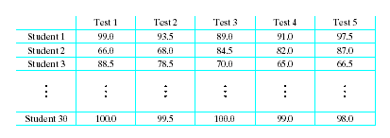
Multidimensional Arrays
Consider a table of test scores for several different students
Two-dimensional array
Syntax ElementType arrayName [numRows][numCols]

Slide 41

Multidimensional Arrays
Consider multiple pages of the student grade book const int NUM_ROWS = 10, NUM_COLS = 5, NUM_RANKS = 10; typedef double ThreeDimArray[NUM_ROWS][NUM_COLS][NUM_RANKS];
. . .

Slide 42
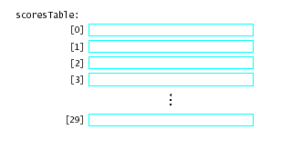
Array of Array Declarations
An array of arrays
An array whose elements are other arrays

Slide 43
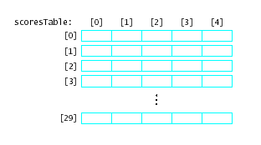
Array of Array Declarations
Each of the rows is itself a one dimensional array of values
scoresTable [1][3]
scoresTable[2]
is the whole row numbered 2

Slide 44
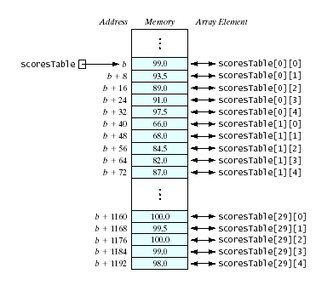
Memory Allocation in 2-Dimensional Arrays
Elements stored in rowwise order
Also called column major order
location [0][4] is followed in memory by location [1][0]

Slide 45
Multidimensional Arrays as Parameters
Must specify
The type and name of the array (a pointer to the base address)
The number of rows
The number of columns (or the length of each row)
Note example program

Slide 46
Dynamic Arrays
Recall earlier mention of arrays being fixed size at compile time
Space wasted by unused elements
Program cannot adjust if size set too small
Dynamic (run time) allocation mechanism provided
Acquire memory as needed
Release memory when no longer needed
C++ commands
new and delete

Slide 47
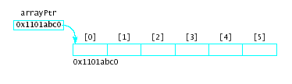
The new Operator
Syntax for arrays new Type [capacity]
This command issues a run-time request for a block of memory
Asks for enough memory for the specified number of elements of the stated type
Example int *arrayPtr; arrayPtr = new int[6];

Slide 48
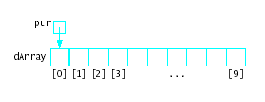

Pointer Arithmetic
Possible to alter pointer contents
The pointer is a variable
It is not a pointer constant like an array name
Example Given:
Then ptr++;

Slide 49
Failures of new
When new execute
Requests memory from heap or free store
Allocates that block to executing program
Possible to use up available heap memory
If not enough memory for request, new throws an exception … bad_alloc
Note sample program, Fig. 3.8
Possible to use try and catch mechanism to take appropriate action, Fig 3.9

Slide 50
The delete Operation
Counterpart to the new operation
Requests memory be returned to the heap
Can then be reused by later allocations
Syntax delete pointerVariable; delete [ ] arrayPointerVariable;
Frees the dynamically memory whose address is stored in the variable
Does not delete the variable

Slide 51
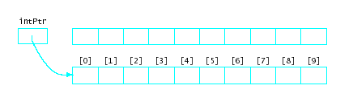
Memory Leaks
Important for programmer to make sure to deallocate memory originally allocated by new
What if new is called again for intPtr?
Originally allocated memory now cannot be accessed, nor is it available for reallocation

Slide 52
Other Uses of Pointers
Command-line arguments
argc is the counter – how many arguments are found
argv is a pointer to the array of pointers to char (the arguments)
Functions as arguments
The name of a function is a pointer to code
Can be passed to another function

Slide 53
Aggregate Data Types
Predefined types not always adequate to model the problem
When objects have multiple attributes
When objects have collections of heterogeneous elements
C++ provides structs and classes
Create new types with multiple attributes

Slide 54
Structures
Characteristics
has a fixed size
is ordered
elements may be of different size
direct access of elements by name (not index)
struct Date { int month, day, year; char dayOfWeek [12];
};

Slide 55
FAQs about Structures
structs can be nested (can contain struct objects)
Access members with
name of struct object
dot (member selector operator) .
name of struct member
Date today = { 3, 4, 2005, "Tuesday");
cout << today.month;

Slide 56
Pointers to Structs
Pointers can be bound to any type Date today = { 3, 4, 2005, "Tuesday"); Date *datePtr = &today;
Use for accessing the original location cout << (*datePtr).day; cin >> datePtr->year;
Note use of arrow -> operator

Slide 57
Description of Procedural Programming
Typical languages : C, FORTRAN, and Pascal
Action-oriented — concentrates on the verbs
Programmers:
Identify basic tasks to solve problem
Implement actions to do tasks as subprograms (procedures/functions/ subroutines)
Group subprograms into programs/modules/libraries,
together make up a complete system for solving the problem

Slide 58
Example of Procedural Programming
Consider a type for processing times
In hh:mm AM/PM format
In military format (24 hr clock)
We must determine
Data attributes
Operations on the data
How to implement
Note sample header, Fig. 3-11A
Implementation, Fig. 3-11B
Test program, Fig. 3-11C

Slide 59
More about OOP and ADTs Classes
Chapter 4
Nyhoff, ADTs, Data Structures and Problem Solving with C++, Second Edition, © 2005 Pearson Education, Inc. All rights reserved. 0-13-140909-3
59

Slide 60
Chapter Contents
4.1 Procedural vs. Object-Oriented Programming
4.2 Classes
4.3 Example: A First Version of a User-Defined Time Class
4.4 Class Constructors
4.5 Other Class Operators
Nyhoff, ADTs, Data Structures and Problem Solving with C++, Second Edition, © 2005 Pearson Education, Inc. All rights reserved. 0-13-140909-3
60

Slide 61
Chapter Objectives
Contrast OOP with procedural programming
Review classes in C++
Study in detail a specific example of how a class is built
Show how operators can be overloaded for new types
Show how conditional compilation directives are used to avoid redundant declarations
Discuss pointers to class objects – the this pointer, in particular
Nyhoff, ADTs, Data Structures and Problem Solving with C++, Second Edition, © 2005 Pearson Education, Inc. All rights reserved. 0-13-140909-3
61

Slide 62
Contrast Procedural, Object Oriented Paradigms
Object-oriented
Focuses on the nouns of problem specification
Programmers:
Determine objects needed for problem
Determine how they should work together to solve the problem.
Create types called classes made up of
data members
function members to operate on the data.
Instances of a type (class) called objects.
Procedural
Action-oriented — concentrates on the verbs
Programmers:
Identify basic tasks to solve problem
Implement actions to do tasks as subprograms (procedures/functions/ subroutines)
Group subprograms into programs/modules/libraries,
together make up a complete system for solving the problem
Nyhoff, ADTs, Data Structures and Problem Solving with C++, Second Edition, © 2005 Pearson Education, Inc. All rights reserved. 0-13-140909-3
62
Notes:
62

Slide 63
Structs and Classes Similarities
Essentially the same syntax
Both are used to model objects with multiple attributes (characteristics)
represented as data members
also called fields … or …
instance or attribute variables).
Thus, both are used to process non-homogeneous data sets.
Nyhoff, ADTs, Data Structures and Problem Solving with C++, Second Edition, © 2005 Pearson Education, Inc. All rights reserved. 0-13-140909-3
63

Slide 64
Structs vs. Classes Differences
No classes in C
Members public by default
Can be specified private
Both structs and classes in C++
Structs can have members declared private
Class members are private by default
Can be specified public
Nyhoff, ADTs, Data Structures and Problem Solving with C++, Second Edition, © 2005 Pearson Education, Inc. All rights reserved. 0-13-140909-3
64

Slide 65
Advantages in C++ (structs and Classes)
C++ structs and classes model objects which have:
Attributes represented as data members
Operations represented as functions (or methods)
Leads to object oriented programming
Objects are self contained
"I can do it myself" mentality
They do not pass a parameter to an external function
Nyhoff, ADTs, Data Structures and Problem Solving with C++, Second Edition, © 2005 Pearson Education, Inc. All rights reserved. 0-13-140909-3
65

Slide 66
Class Declaration
Syntax class ClassName { public: Declarations of public members private: Declarations of private members };
Nyhoff, ADTs, Data Structures and Problem Solving with C++, Second Edition, © 2005 Pearson Education, Inc. All rights reserved. 0-13-140909-3
66

Slide 67
Designing a Class
Data members normally placed in private: section of a class
Function members usually in public: section
Typically public: section followed by private:
although not required by compiler
Nyhoff, ADTs, Data Structures and Problem Solving with C++, Second Edition, © 2005 Pearson Education, Inc. All rights reserved. 0-13-140909-3
67

Slide 68
Class Libraries
Class declarations placed in header file
Given .hpp extension
Contains data items and prototypes
Implementation file
Same prefix name as header file
Given .cpp extension
Programs which use this class library called client programs
Nyhoff, ADTs, Data Structures and Problem Solving with C++, Second Edition, © 2005 Pearson Education, Inc. All rights reserved. 0-13-140909-3
68

Slide 69
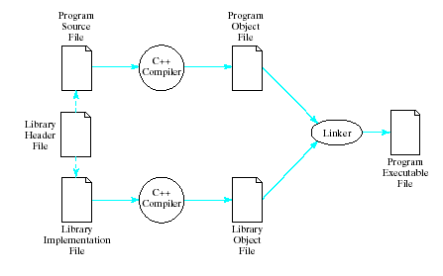
Translating a Library
Nyhoff, ADTs, Data Structures and Problem Solving with C++, Second Edition, © 2005 Pearson Education, Inc. All rights reserved. 0-13-140909-3
69

Slide 70
Example of User-Defined Time Class
Recall Time struct from previous chapter
Actions done to Time object required use of Time parameter in the functions
Now we create a Time class
Actions done to Time object, done by the object itself
Note interface for Time class object, Fig. 4.2
Data members private – inaccessible to users of the class
Information hiding
Nyhoff, ADTs, Data Structures and Problem Solving with C++, Second Edition, © 2005 Pearson Education, Inc. All rights reserved. 0-13-140909-3
70

Slide 71
Constructors
Note constructor definition in Time.cpp example
Syntax ClassName::ClassName (parameter_list) : member_initializer_list { // body of constructor definition }
Nyhoff, ADTs, Data Structures and Problem Solving with C++, Second Edition, © 2005 Pearson Education, Inc. All rights reserved. 0-13-140909-3
71

Slide 72
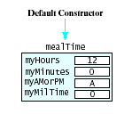
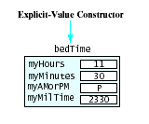
Constructors
Results of default constructor
Results of explicit-value constructor
Nyhoff, ADTs, Data Structures and Problem Solving with C++, Second Edition, © 2005 Pearson Education, Inc. All rights reserved. 0-13-140909-3
72

Slide 73
Overloading Functions
Note existence of multiple functions with the same name Time(); Time(unsigned initHours, unsigned initMinutes, char initAMPM);
Known as overloading
Compiler compares numbers and types of arguments of overloaded functions
Checks the "signature" of the functions
Nyhoff, ADTs, Data Structures and Problem Solving with C++, Second Edition, © 2005 Pearson Education, Inc. All rights reserved. 0-13-140909-3
73

Slide 74
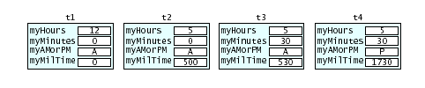
Default Arguments
Possible to specify default values for constructor arguments Time(unsigned initHours = 12, unsigned initMinutes = 0, char initAMPM = 'A');
Consider Time t1, t2(5), t3(6,30), t4(8,15,'P');
Nyhoff, ADTs, Data Structures and Problem Solving with C++, Second Edition, © 2005 Pearson Education, Inc. All rights reserved. 0-13-140909-3
74

Slide 75
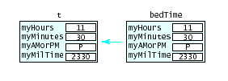
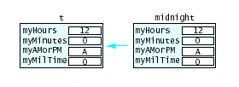
Copy Operations
During initialization Time t = bedTime
During Assignment t = midnight;
Nyhoff, ADTs, Data Structures and Problem Solving with C++, Second Edition, © 2005 Pearson Education, Inc. All rights reserved. 0-13-140909-3
75

Slide 76
Other Class Operations
Accessors and Mutators
See "getSee "get" and "set" functions
Overloading operators
Same symbol can be used more than one way
Note declaration for I/O operators << and >>
Note definition of overloaded I/O operators
Nyhoff, ADTs, Data Structures and Problem Solving with C++, Second Edition, © 2005 Pearson Education, Inc. All rights reserved. 0-13-140909-3
76

Slide 77
Friend Functions
Note use of two functions used for output
display() and operator<<()
Possible to specify operator<<() as a "friend" function
Thus given "permission" to access private data elements
Declaration in .h file (but not inside class) friend ostream & operator<<( ostream & out, const Time & t)
Nyhoff, ADTs, Data Structures and Problem Solving with C++, Second Edition, © 2005 Pearson Education, Inc. All rights reserved. 0-13-140909-3
77

Slide 78
Friend Functions
Definition in .cpp file ostream & operator<<( ostream & out, const Time & t) { out << t.myHours<<":" <<(t.myMinutes< 10? "0": "") <<t.myMinutes << ' '<<t.myAMorPM<<".M."; return out; }
Note - a friend function not member function
not qualified with class name and ::
receives class object on which it operates as a parameter
Author prefers not to use friend function
Violates principle of information hiding
Nyhoff, ADTs, Data Structures and Problem Solving with C++, Second Edition, © 2005 Pearson Education, Inc. All rights reserved. 0-13-140909-3
78

Slide 79
Other Operations
Advance Operation
Time object receives a number of hours and minutes
Advances itself by adding to myHours, myMinutes
Relational Operators
Time object compares itself with another
Determines if it is less than the other
Nyhoff, ADTs, Data Structures and Problem Solving with C++, Second Edition, © 2005 Pearson Education, Inc. All rights reserved. 0-13-140909-3
79

Slide 80
Redundant Declarations
Note use of #include "Time.h" in
Time.cpp
Client program
Causes "redeclaration" errors at compile time
Solution is to use conditional compilation
Use #ifndef and #define Use #ifndef and #define and #endif compiler directives
Nyhoff, ADTs, Data Structures and Problem Solving with C++, Second Edition, © 2005 Pearson Education, Inc. All rights reserved. 0-13-140909-3
80

Slide 81

Pointers to Class Objects
Possible to declare pointers to class objects Time * timePtr = &t;
Access with timePtr->getMilTime() or (*timePtr).getMilTime()
Nyhoff, ADTs, Data Structures and Problem Solving with C++, Second Edition, © 2005 Pearson Education, Inc. All rights reserved. 0-13-140909-3
81

Slide 82
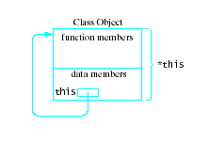
The this Pointer
Every class has a keyword, this
a pointer whose value is the address of the object
Value of *this would be the object itself
Nyhoff, ADTs, Data Structures and Problem Solving with C++, Second Edition, © 2005 Pearson Education, Inc. All rights reserved. 0-13-140909-3
82

